Slide 1
Figure 5. Drought stress increased the microbial load of rice root microbiota revealed by quantitative microbial profiling method.
a. Principal coordinates analysis of Bray Curtis distances showing that rice root microbiota form separate clusters according to drought and wet conditions, as well as genotypes (MH63 and WYJ7DEP1) in Hainan.
b. Bacterial load of rice root microbiota of two rice varieties, MH63 and WYJ, increased under the drought stress condition; Statistical significance was determined by Wilcoxon rank-sum test. Asterisks indicate statistically significant differences (**, P < 0.01; ***, P < 0.001).
c. Heat map showing the fold enrichment of bacterial phyla in the root microbiota of MH63 and WYJ under the drought stress condition using relative abundant (RA) and quantitative abundant (QA) methods. Note that in microbiota of both varieties, the QA method detected an enhanced the enrichment and reduced reduction under the drought stress condition, because the QA method detect the bacterial load increasement under the drought stress condition (Figure 5b).
d. Venn diagram showing the overlap of drought-responsive OTUs detected by the RA and AA method. The orange and blue ellipse represent differential OTUs that were detected by the RA and AA method, respectively. * indicates there are five OTUs which are identified as enriched OTUs using the AA method, but as depleted OTUs using the RA method, suggesting that the microbial load is essential to track the changes of these bacteria.
e. Examples showing that the responses of three OUTs to the drought stress condition varied according to the RA and AA method. Asterisks indicate statistically significant differences (**, P < 0.01; ***, P < 0.001); ns, not significant (adjusted P values are shown).
f. Quantitative abundance of bacterial and fungal load of root microbiota of MH63 and WYJ under drought and wet conditions. Error bars represent means and SE[Office1] s calculated from biological replicates.
For all analyses in Hainan filed site, biological replicate numbers are: MH63 (dry=15, wet=13); WYJ (dry=11, wet=13); bulk soil (dry=6, wet=6).

Slide 2
Fig 5

Slide 3
Fig S9

Slide 4
Fig S10

Slide 5
Fig S11

Slide 6
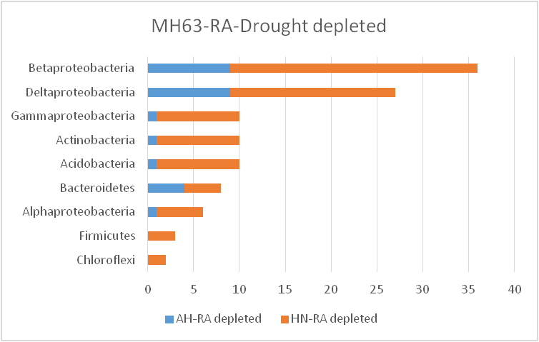
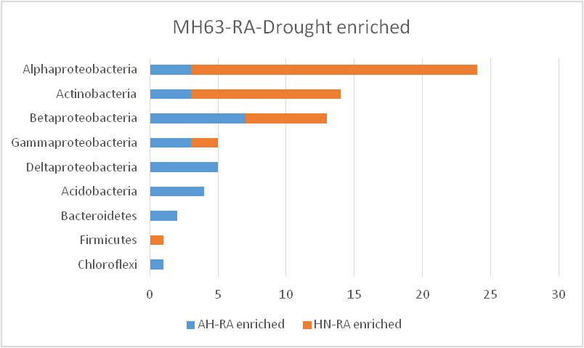
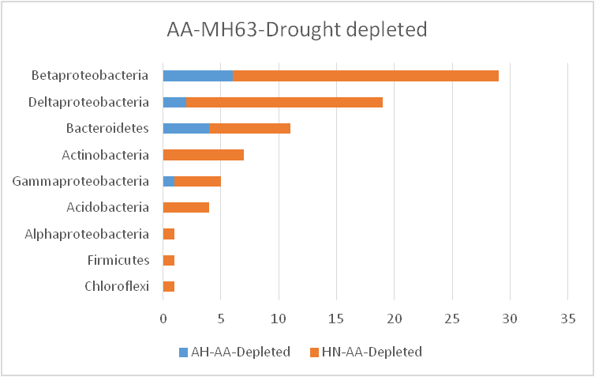
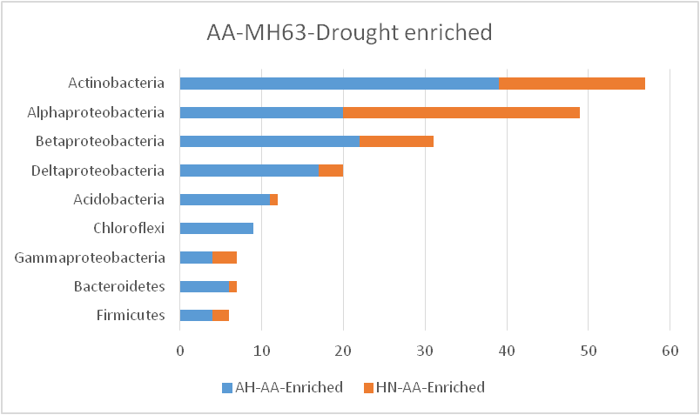
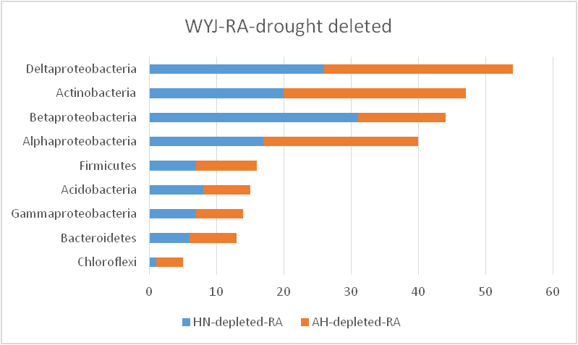
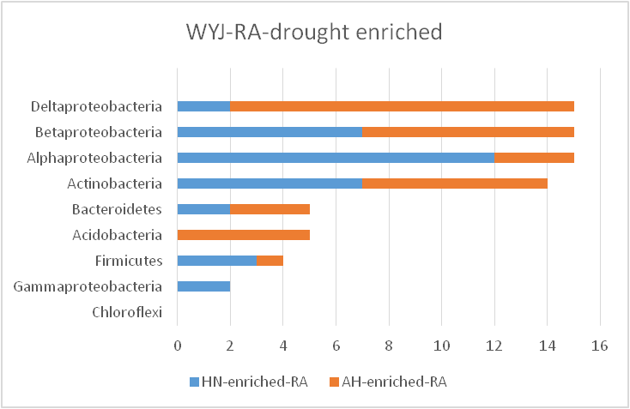
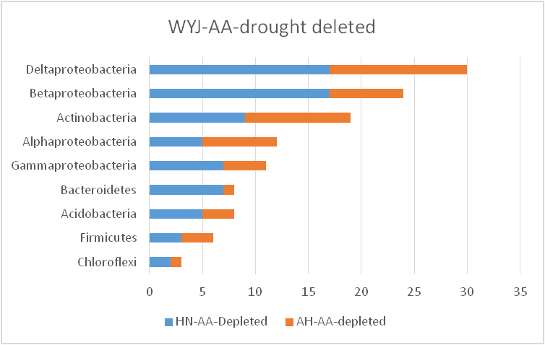
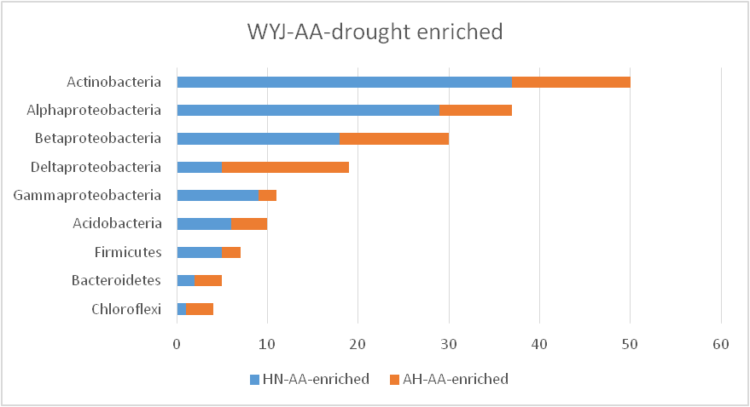
Fig S12 （重新画图）

Slide 7
Fig S13

Slide 8
Fig S14

Slide 9
Fig S15

Slide 10
Figure 6. Microbial load varies between healthy wheat root samples and infected wheat root samples attacked by Bipolaris sorokiniana revealed by quantitative microbial profiling method. Principal coordinates analysis of Bray Curtis distances showing distinctly clustered bacterial (a) and fungal (b) communities according to healthy states. The percentage of variation explained by the plotted principal coordinates is indicated on the axes. In the panel, each point corresponds to a sample: infected root samples, square; healthy root samples, triangle; bulk soil samples, circle. (c) Box plot showing infected samples have significantly higher bacterial and fungal load than healthy samples (P < 0.05). Statistical significance was determined by Wilcoxon rank-sum test. Asterisks indicate statistically significant differences (*, P < 0.05; **, P < 0.01). For all analyses, biological replicate numbers are: infected root samples = 10; healthy root samples =10; bulk soil samples = 5.

Slide 11
Fig 6

